Slide 2

Mobile Programming
Note-taking app
Members:
Chu Trung Anh – 20225564
Bui Duy Anh – 20225563
Supervisor:
Dr.Nguyen Dinh Thuan

Slide 3
Table of content
Introduction
Technology Stack
UI/UX Design
Project Architecture
Demo
Conclusion
Future Work

Slide 4
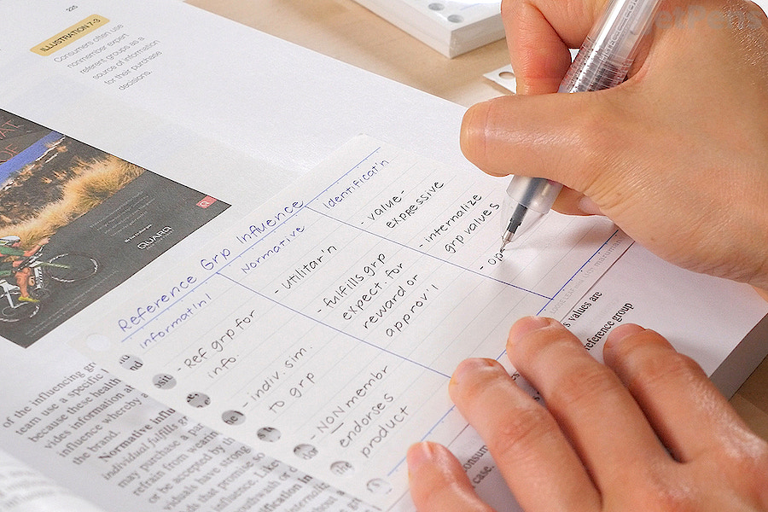

I. Introduction
Taking notes is a crucial activities that many people do regularly and has been many people’s daily routine
Taking notes regularly has been proven to be a good habit which makes their life more organized and planned
Our note-taking app is an assistant helps to remind user what they might forget

Slide 5


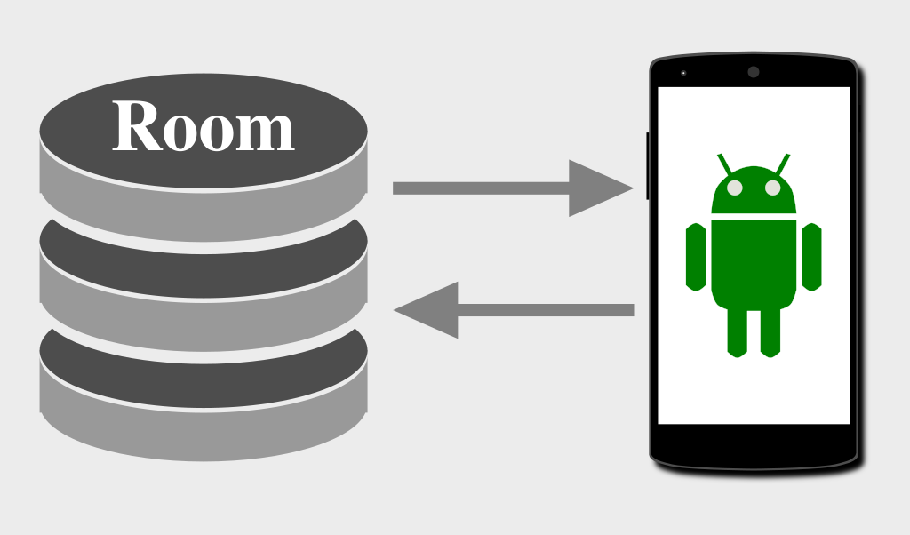
II. Technology Stack
Language: Kotlin
Database:
Local: SQLite for offline storage (Using ROOM dependency to interact with the database)
Remote: Firebase Cloud Storage
Development Tools: Android Studio for coding and debugging.

Slide 6
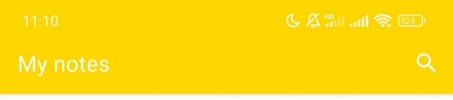
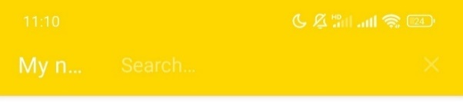
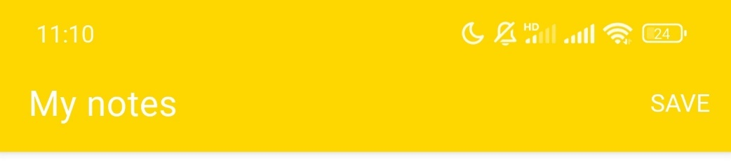
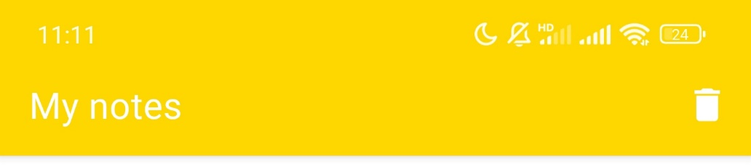
III. UI/UX
Search Menu
Save Menu
Delete Menu

Slide 7
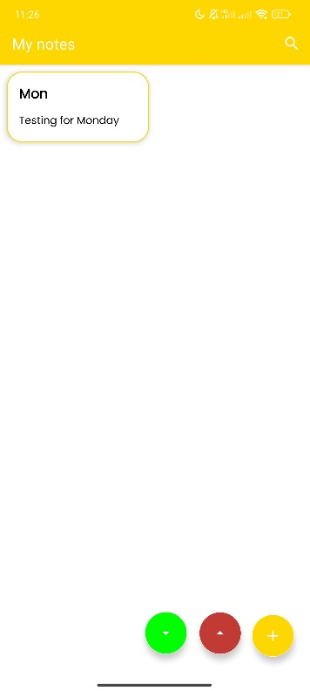
III. UI/UX
A Note item with:
Title
Preview content
Upload button
Fetch button
Add new Note button
Home fragment

Slide 8
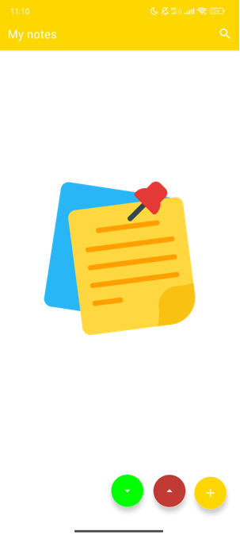
III. UI/UX
Home fragment when there is no note

Slide 9
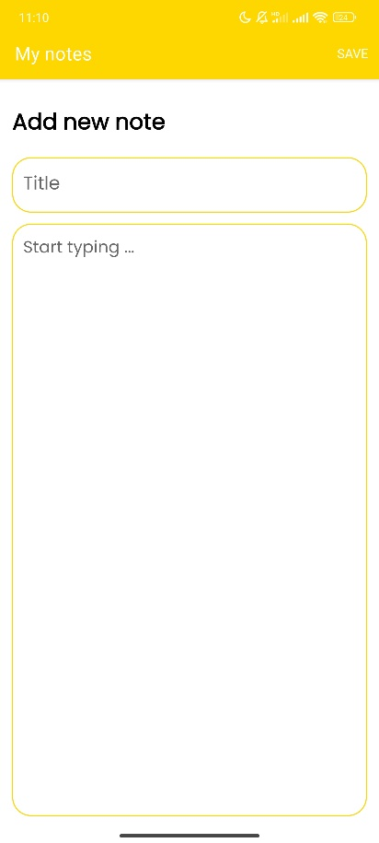
III. UI/UX
Save Note button
Add note fragment

Slide 10
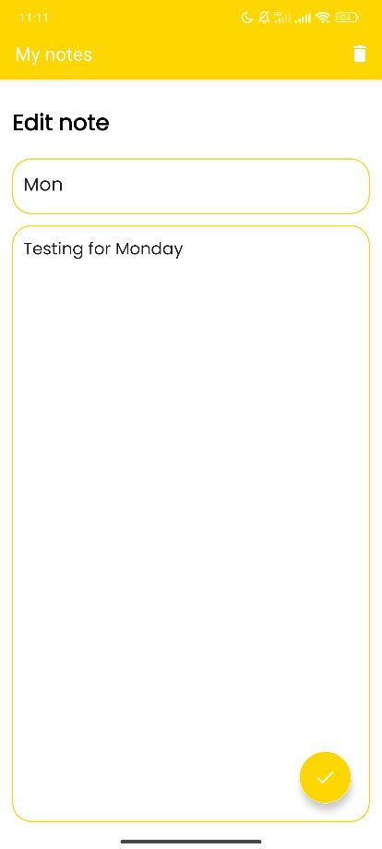
III. UI/UX
Delete Note button
Update Note button
Edit note fragment

Slide 11
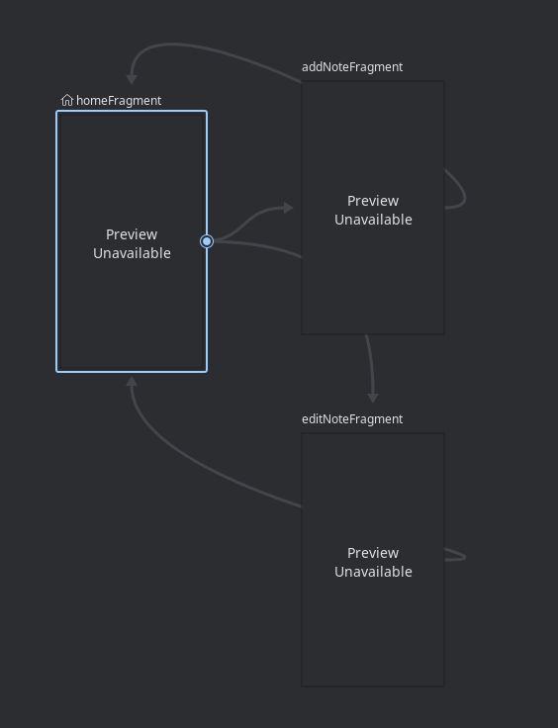
III. UI/UX
Use navigation graph to move between fragments

Slide 12
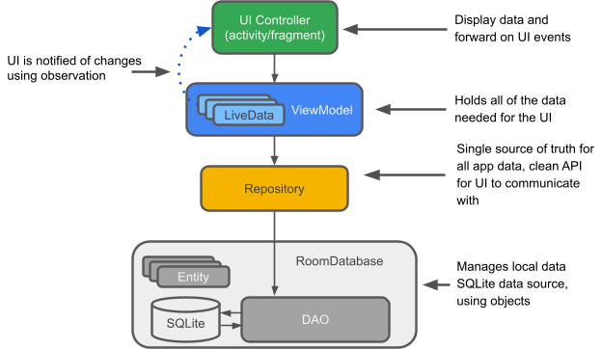
IV. Architecture

Slide 13
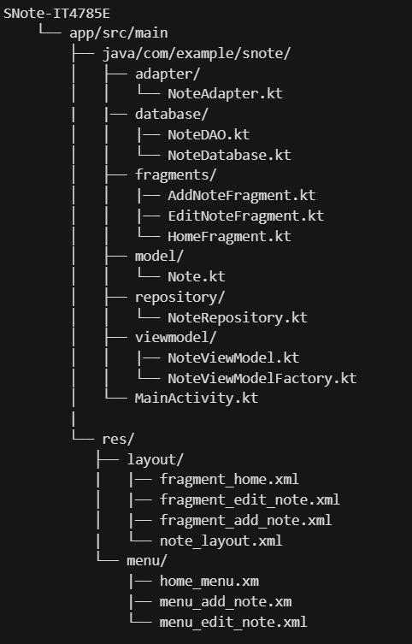
IV. Architecture

Slide 14

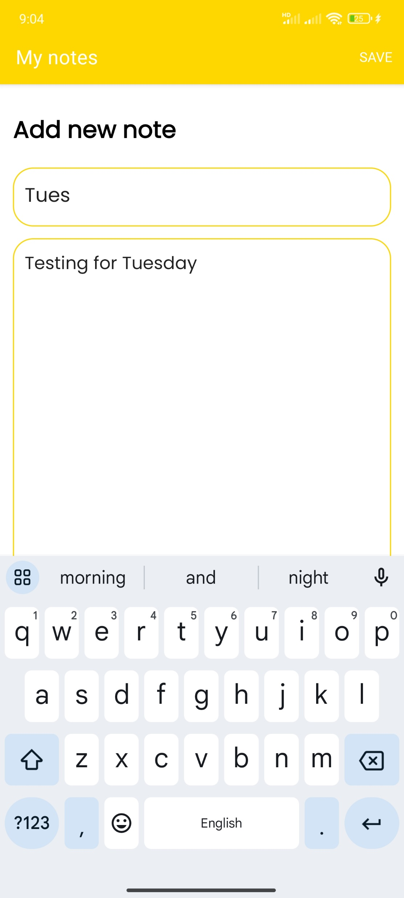
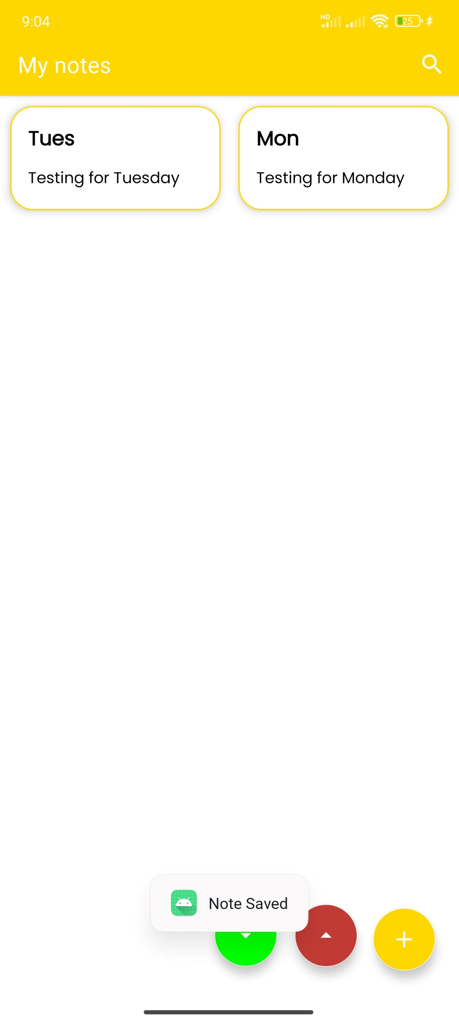
V. Demo – Add new note
Add new note
Update UI
Confirm message

Slide 15
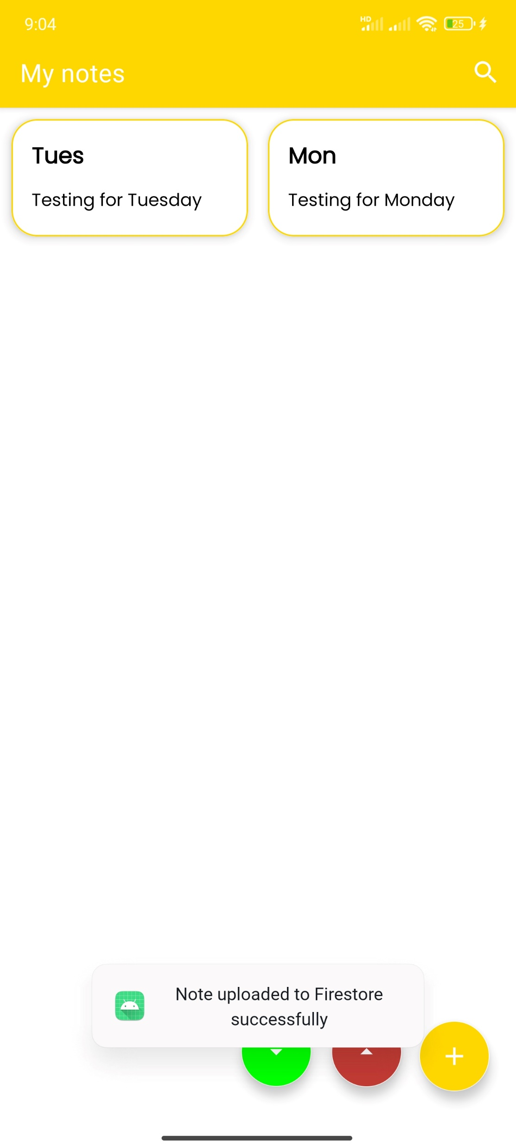
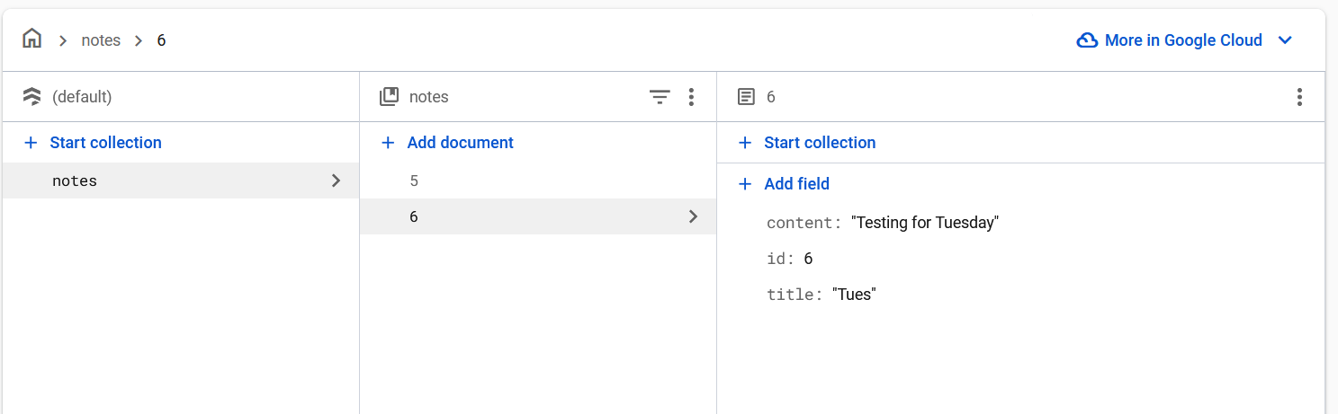
V. Demo – Upload
Check on the Firebase Cloud website, we see two corresponding Note object
Click the red upload button

Slide 16
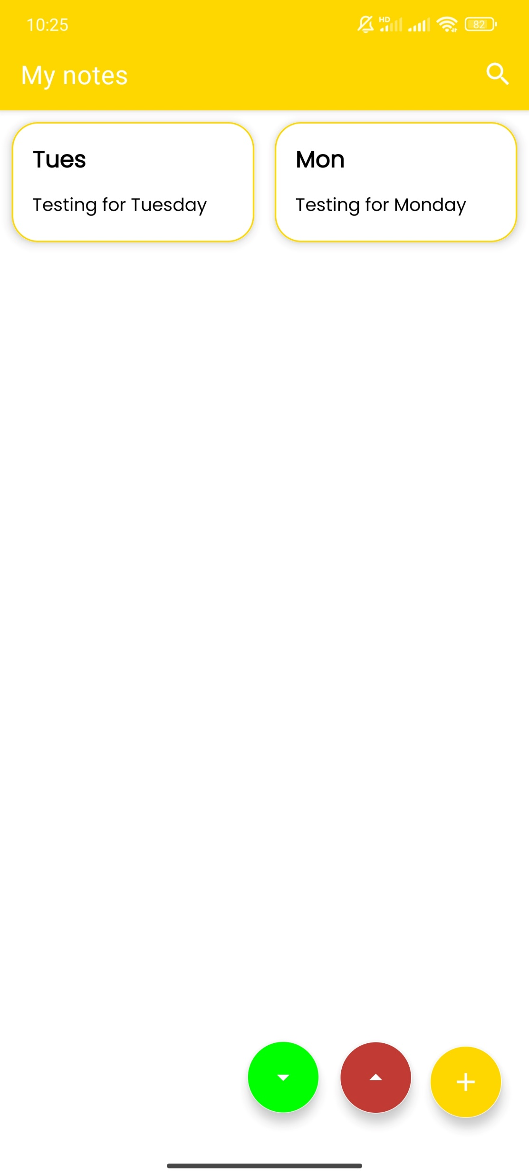
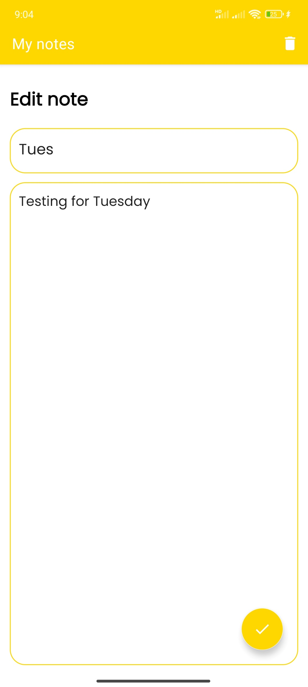
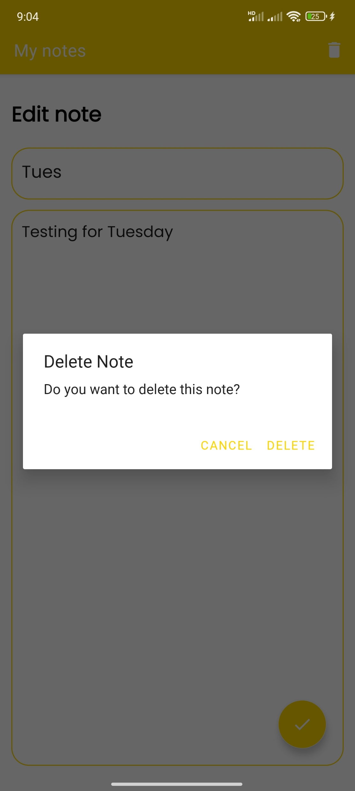
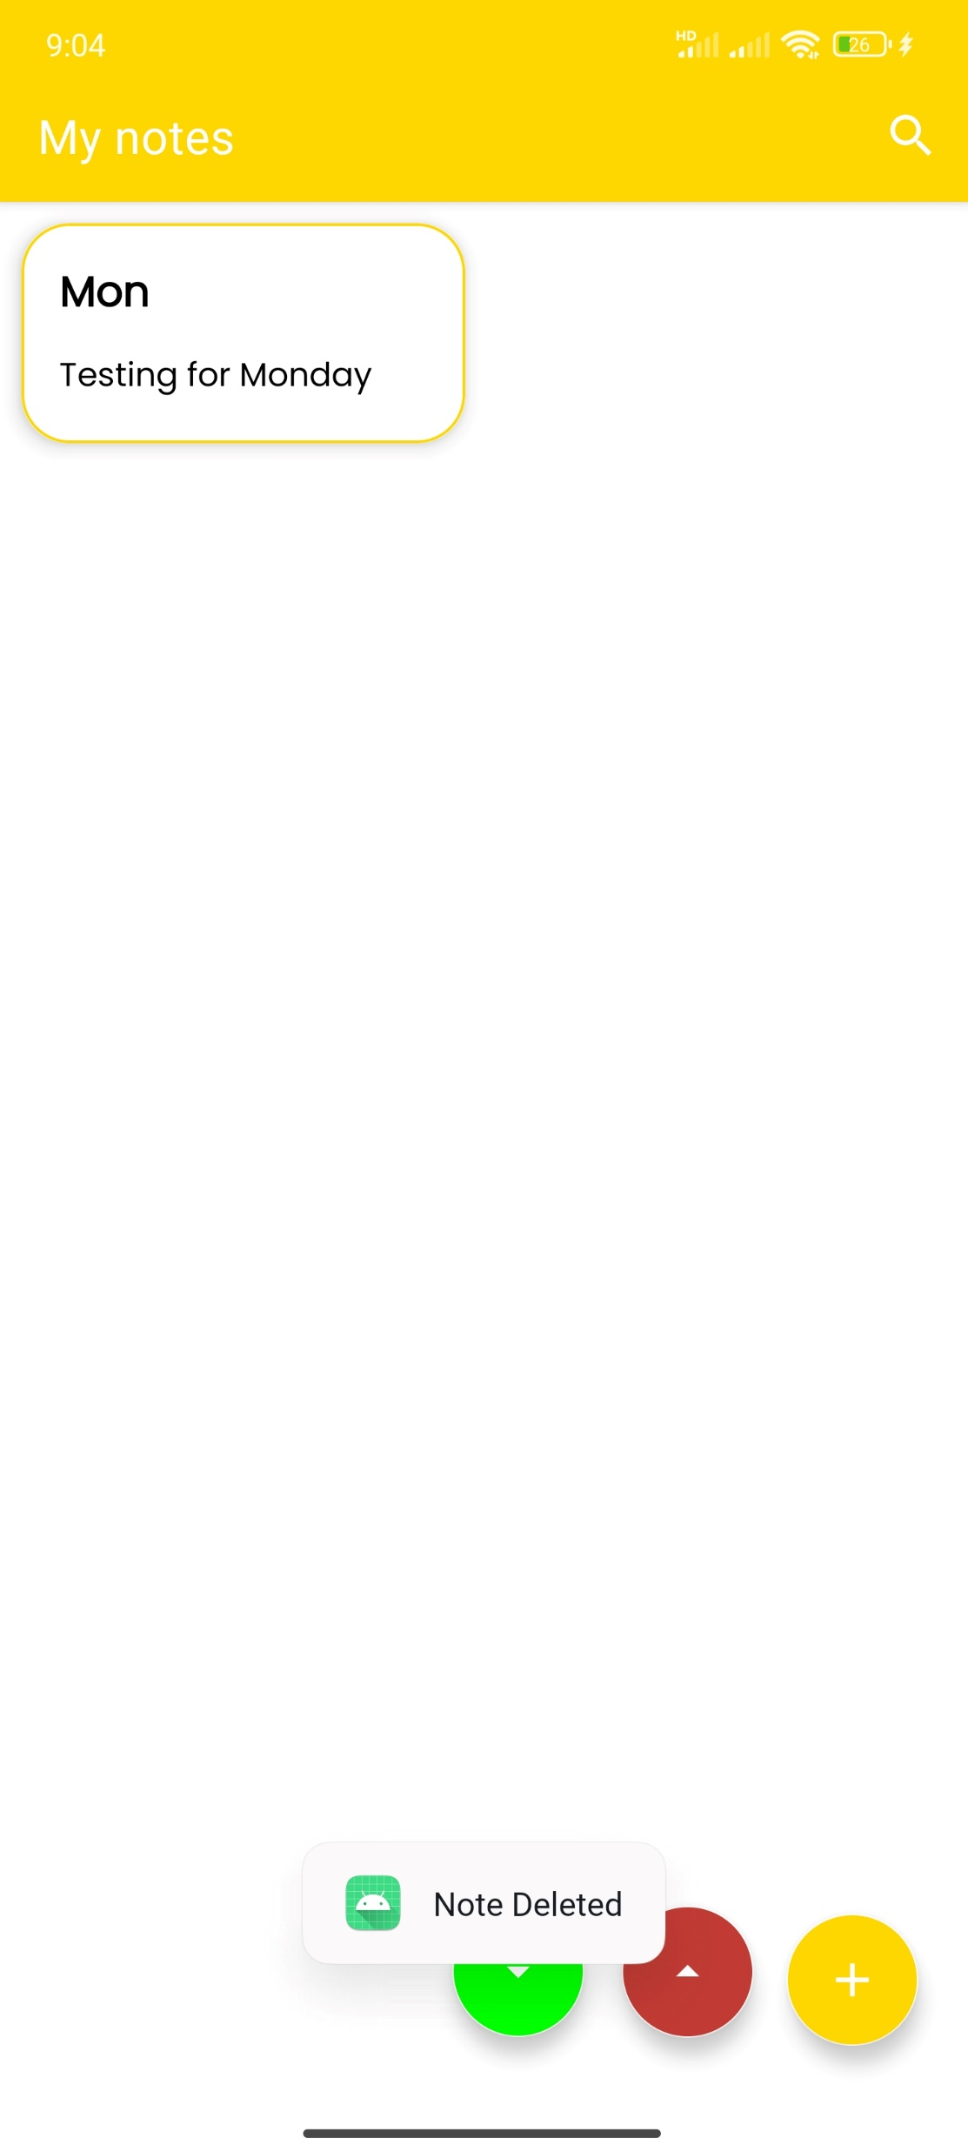
V. Demo – Edit note
Delete confirm dialog
Click on Tues note item
Update UI

Slide 17

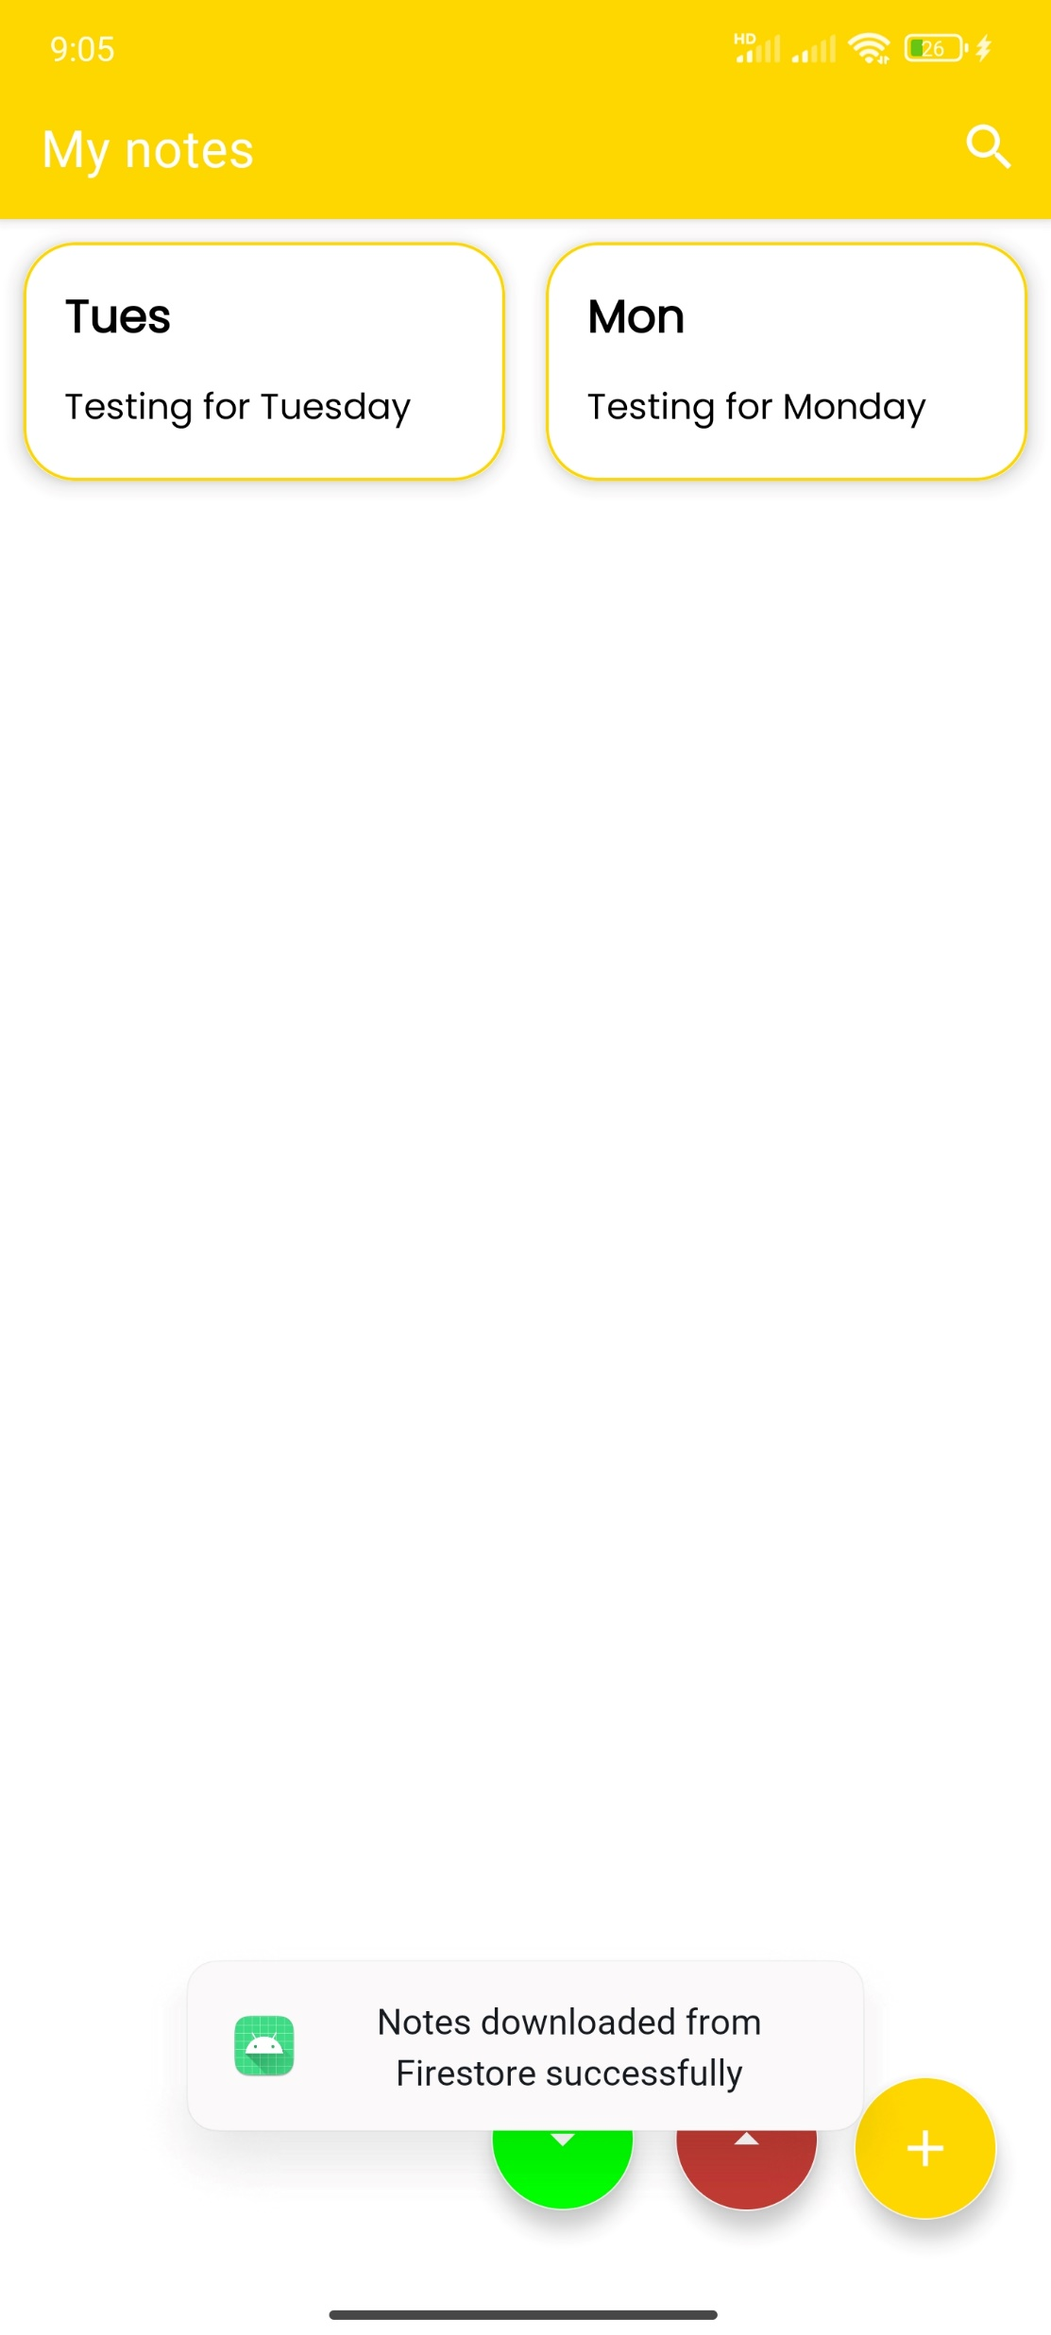
V. Demo – Fetch note
Currently, there are two notes in the cloud database
Click on Green Fetch button
Update local database and UI

Slide 18

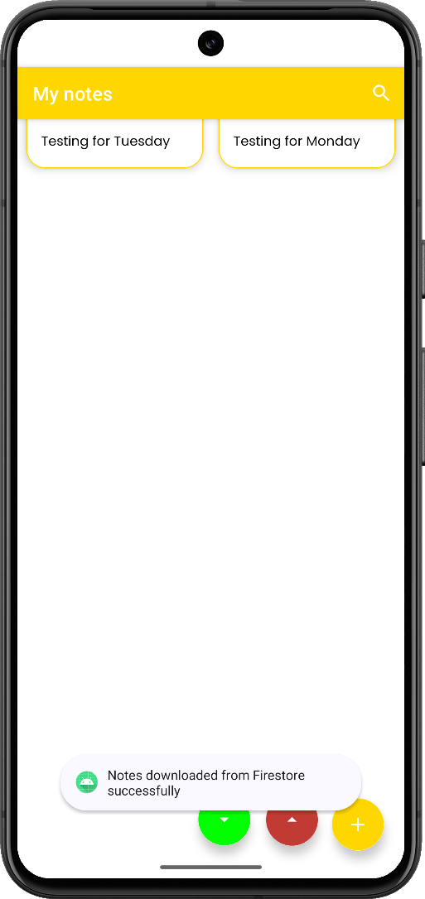
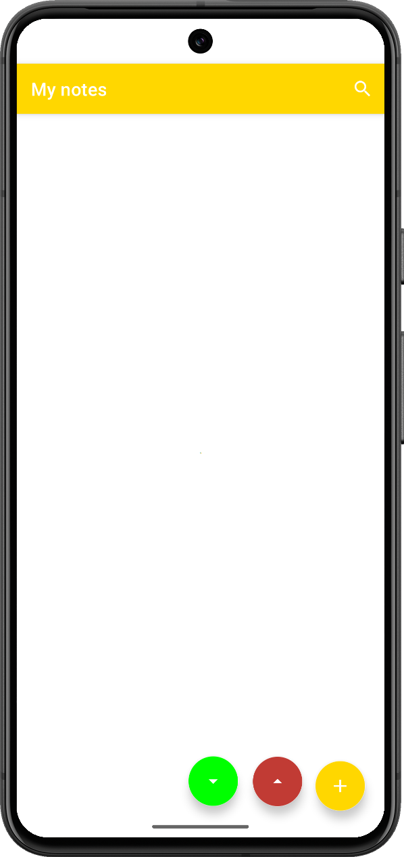
V. Demo – Sync between devices
Device 1
Device 1
Firebase Cloud Storage
Add note, then save to Cloud
Device 2
Device 2
Fetch note

Slide 19
VI. Conclusion
Successfully developed a feature-rich note-taking app with offline and online capabilities.
Seamless synchronization between local SQLite storage and a remote server.
User-friendly interface designed for ease of navigation and functionality
For the detail code implementation and explanation, visit our GitHub repository: https://github.com/chutrunganh/SNote-IT4785E.git

Slide 20
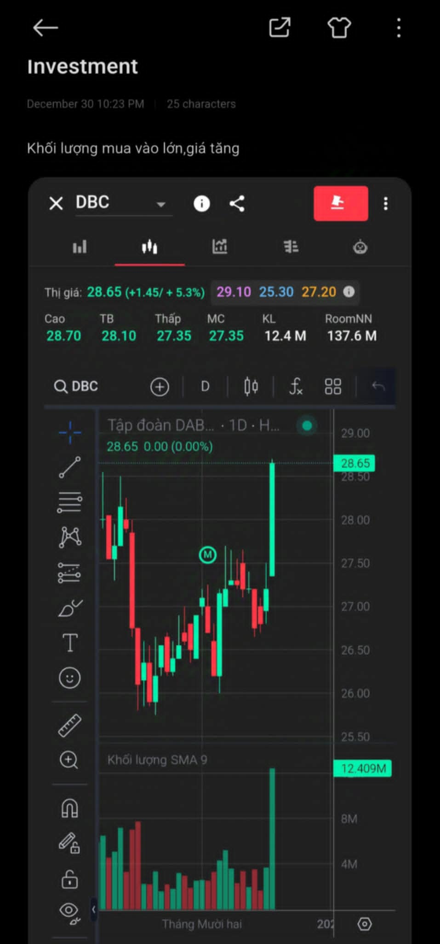
VI. Future Work
Let user change background of the app
Enable adding picture to the note. Example:
Tag/pin the notes
Have permissions control (notes that only the owner can see)
AI-integrated to remind event through virtual assistant on the phone

Slide 21
THANK YOU !

